Slide 1
MAGNETIC DISK

Slide 2
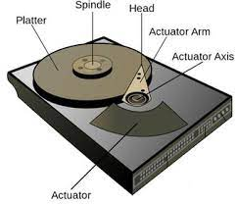
Magnetic Disk

Slide 3
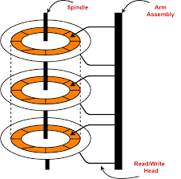
Magnetic Disk

Slide 4
Magnetic Disk
Magnetic disks are flat circular plates of metal or plastic, coated on both sides with iron oxide.
Input signals, which may be audio, video, or data, are recorded on the surface of a disk as magnetic patterns or spots in spiral tracks by a recording head while the disk is rotated by a drive unit.

Slide 5
Magnetic Disk
A magnetic disk is a storage device that uses a magnetization process to write, rewrite and access data.
It is covered with a magnetic coating and stores data in the form of tracks, spots and sectors.
Hard disks and floppy disks are common examples of magnetic disks.
Both sides of the disk of HDD are used for storing data except the upper side of the uppermost disk and the lower side of the lowermost disk.

Slide 6
Advantage of Magnetic Disk
Long life and reliable. Magnetic tape storage has been proven to have a lifespan of over thirty years, making it ideal for long term backups.
High capacity storage
Inexpensive
Data security
Reusable memory

Slide 7
Disadvantage of Magnetic Disk
Requires maintainance
  Avoidance of heat such as strong sunlight or radiators
  Avoidance of contact with water
  Maintained at a regulated temperature (18-21 degrees)
  Maintained away from technology such as televisions, microwaves or heavy machinery
  Maintained at the same orientation
  Ensuring care when transporting and handling

Slide 8
Disadvantage of Magnetic Disk
Susceptible to damage
  Although reliable when kept in a controlled environment, magnetic tapes can be at risk when it comes to fire and water damage.
  Needs specialist equipment
  Unfortunately magnetic tape storage does require specialist equipment to transfer data onto the tape, and for data to be recovered from it.

Slide 9
Optical Disk

Slide 10
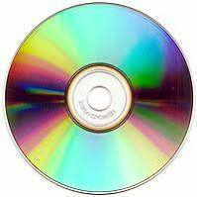
Optical Disk

Slide 11
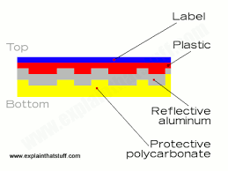

Slide 12
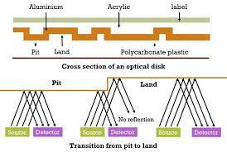

Slide 13
How data is stored
Optical storage, electronic storage medium that uses low-power laser beams to record and retrieve digital (binary) data.
In optical-storage technology, a laser beam encodes digital data onto an optical, or laser, disk in the form of tiny pits arranged in a spiral track on the disk's surface.

Slide 14
Advantages
One of the biggest advantages of optical storage over other storage media is durability.
Optical discs are not vulnerable to data loss due to power failure like volatile memory, and they're not as subject to wear as non-volatile memory (NVM) such as HDDs.

Slide 15
Disadvantages
Optical discs are also slower to read and write data than other devices, as they rely on mechanical parts and spinning motion.
Furthermore, optical drives are bulky and noisy, and they consume more power than other devices.

Slide 16
Difference: Magnetic and Optical Disk
Magnetic Disk | Optical Disk
Tracks are circular | Tracks are spiral
Random Access | Sequential Access
Slow | Fast
High Storage Capacity | Low Storage Capacity
Holds data and instructions | Holds audio, video etc
Hard Disk Floppy Disk | CD DVD

Slide 17
Thank you

